Slide 1
27
Discrete Mathematics
Introduction to Functions

Slide 2






























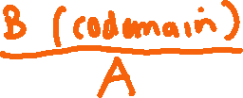

Slide 3
















Slide 4










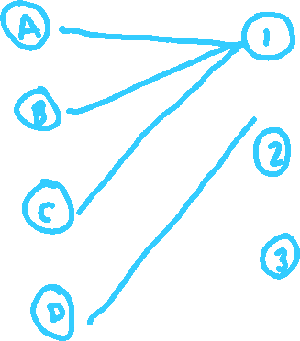






Slide 5
Up Next…
One-to-One and Onto Functions

